Slide 1
Game design report
game name: Seek to survive
Long Liu
2024-01-01

Slide 2
CONTENTS
Game design report
Game name: Seek to survive
Long Liu 20104729
Software system practice Year 4
Date:29/12/2023
Supervisor: Mairead Meagher
1. Game Overview
Gameplay and Mechanics
Story, Setting and Character
4.Interface
5. Technical
Project Management
Appendices

Slide 3
1. Game Overview
01

Slide 4

1 Game Concept
4 Game Flow Summary
1. Game Overview
2 Genre
5 Look and Feel
3 Target Audience
6 Project Scope

Slide 5

1 Game Concept
This game is Horizon version adventure game. Players can move, left and right. Players have a base to upgrade abilities. The enemy will appear at a fixed range and attack the player. As time goes on, the player can collect materials to make tools and update modes. By these objects, payers can increase the maximum life value. When the game enters some specific days? Should this be ‘places’, some enemies will actively attack the player's base. Player needs to guard the base to avoid failure of the game. Player can gain materials by killing enemies and collecting ‘collecting what?”. Materials can be used to upgrade base and player. On the base, player can build defense buildings.

Slide 6

2 Genre
side-scroller: A side-scrolling video game (alternatively side-scroller) is a [game](https://en.wikipedia.org/wiki/Game" o "Game) viewed from a side-view camera angle where the screen follows the [player](https://en.wikipedia.org/wiki/Player_character" \o "Player character) as they move left or right. [1]
Tower Defense: Tower defense (TD) is a subgenre of strategy games where the goal is to defend a player's territories or possessions by obstructing the enemy attackers or by stopping enemies from reaching the exits, usually achieved by placing defensive structures on or along their path of attack.[2]
Base Building: The player will build base to improve their strength, such as more buildings and people.
Single player: The game has only one player.

Slide 7

3 Target Audience
My target audience will be people who have interests in adventure games. It mainly refers to players who can accept pixel style, combat with enemies and discover new things. Targeting the market for high school students and college students.

Slide 8
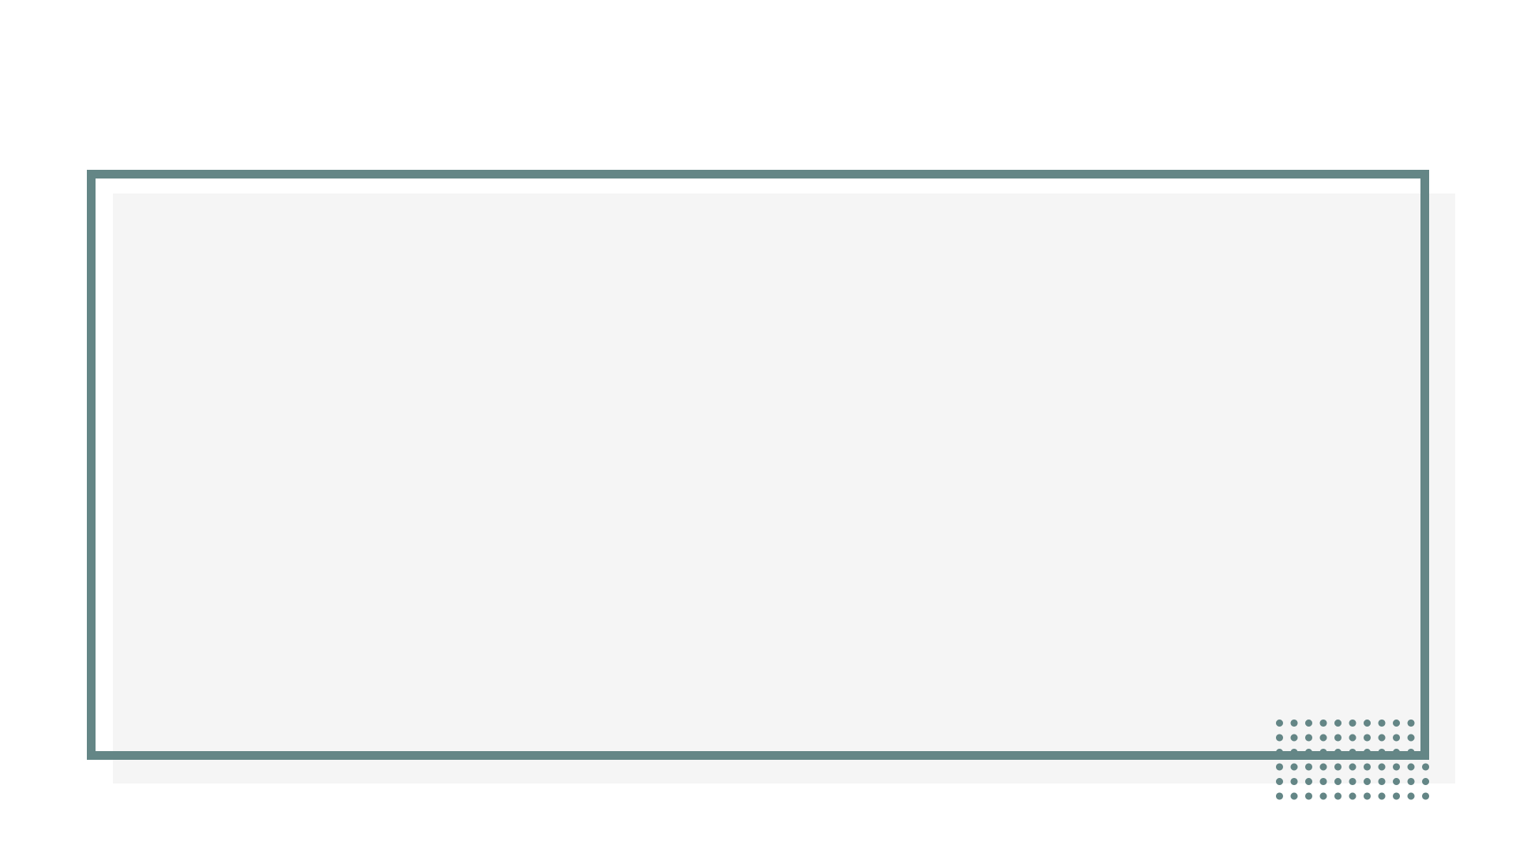
4 Game Flow Summary
The game will load the main menu, where players can select new games, options, or archives. In the game itself, player needs to upgrade base to the highest level, and hold the base during an attack triggered by the upgrade.

Slide 9
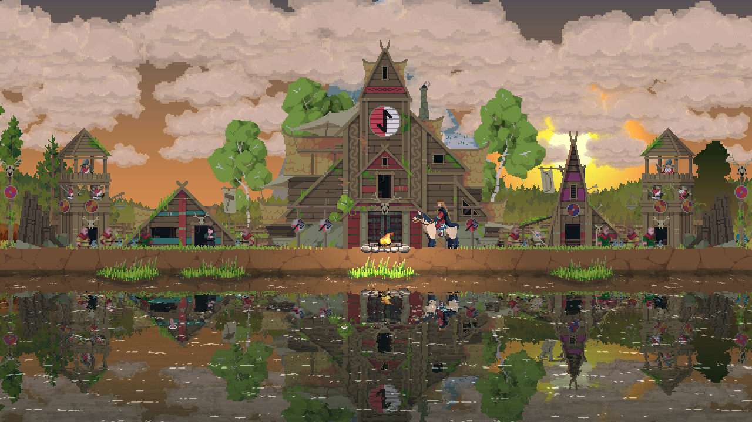
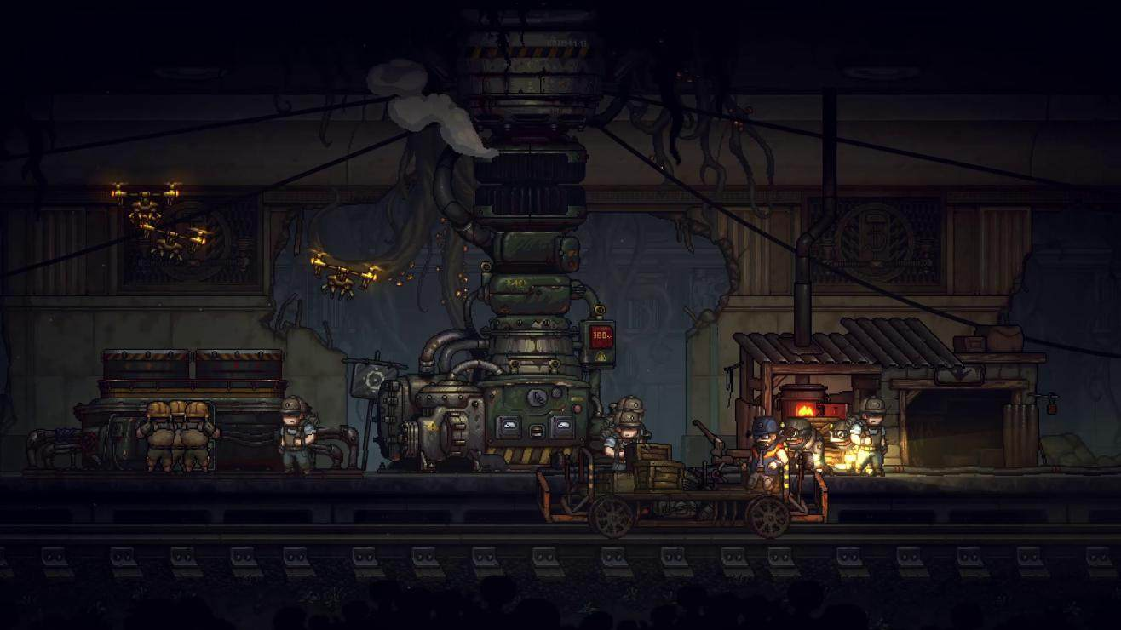
5 Look and Feel
I want the game to look and feel like a pixel adventure game. Similar to “Kingdom: New Lands(fig1)” or “Until We Die(fig2)”. Here are some relevant games pictures:
Figure1.1 Kingdom: New Lands
Figure1.2 Until We Die

Slide 10
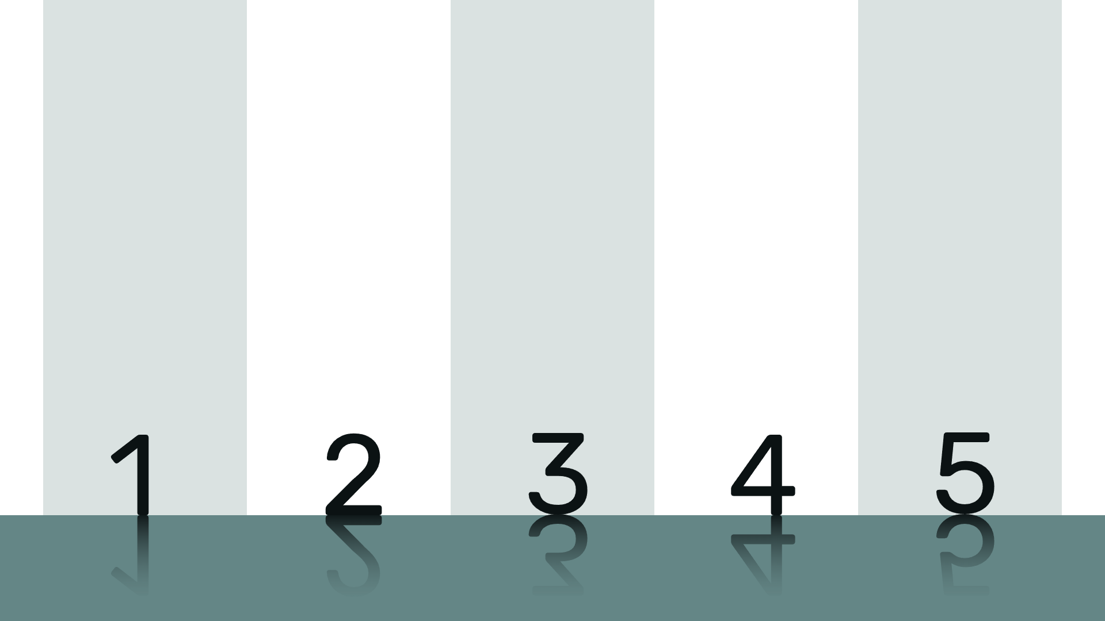
6 Project Scope
1.6.1. Number of Location
1.6.2. Number of Enemies
1.6.3. Number of Buildings
1.6.4. Types of non-Player Character (NPC)
1.6.5. Description of Player

Slide 11
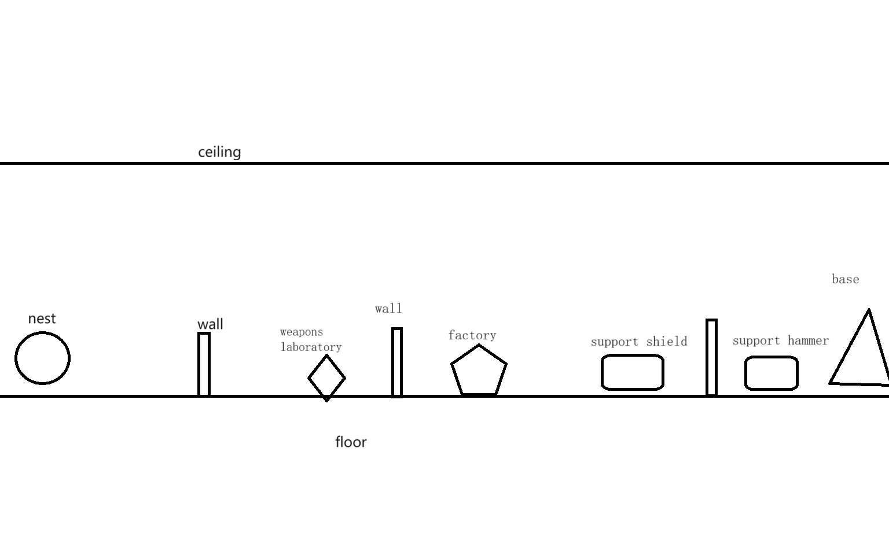
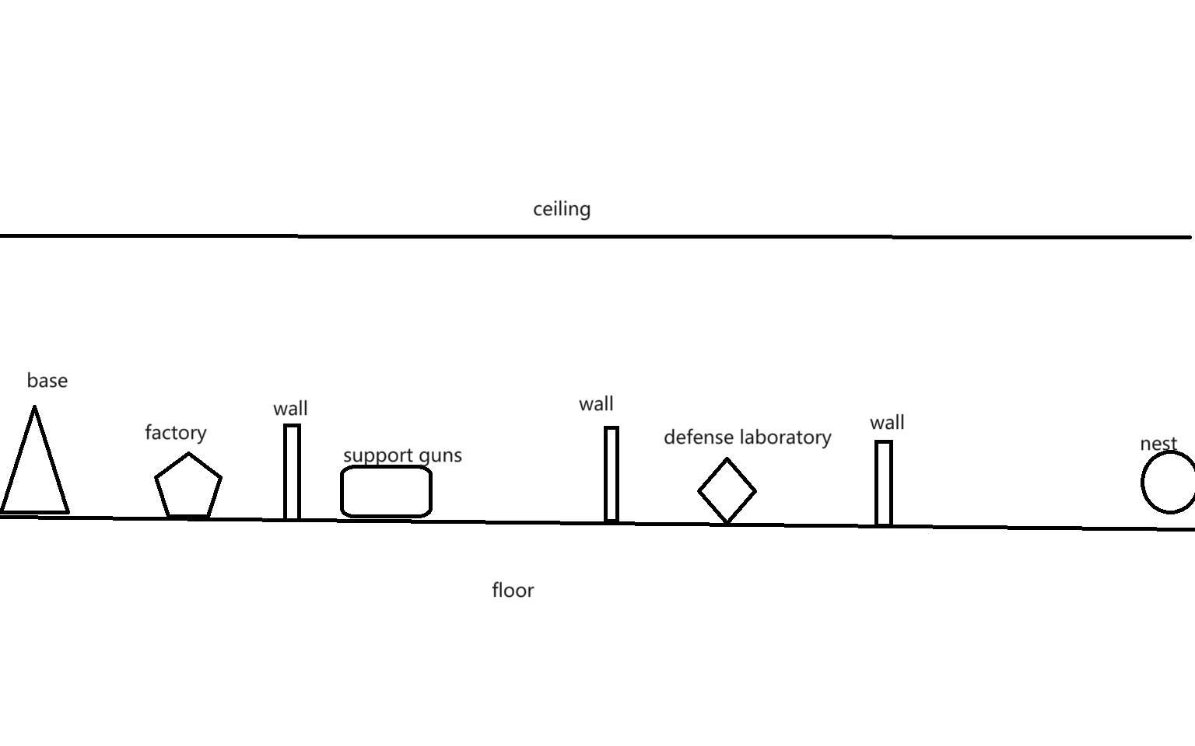
1.6.1. Number of Location
Player and enemies will belong to an only one map. Player and base will appear on the centre of the map, and enemy nests will appear on the two ends of the map. Some broken buildings or hidden buildings will appear in the space between the base and the nests. Player can repair these broken buildings to get some annexes. These annexes can support some extra functions.
Annexe： a building that is added to, or is near, a larger one and that provides extra living or work space.
Fig1.3 Left half map
Fig1.4 Right half map

Slide 12

1.6.2. Number of Enemies
There will be three kinds of enemies.
All enemies come from nest.

Slide 13
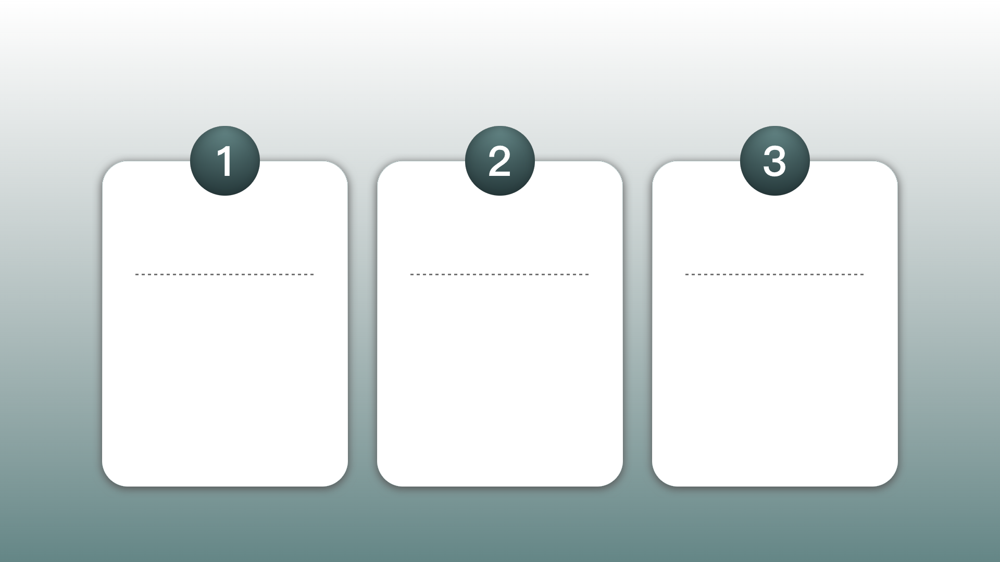
There will be three kinds of enemies.
Crawler: attack from above, low health, fast speed , medium attack power
Attacker: attack from frontal, medium heath, medium speed ,medium power
Thrower: range attack, low heath medium speed, medium attack power

Slide 14

1.6.3. Number of Buildings
Base location: 1 base, 2 nests
Annexe types:
1.6.3.1 Details of Buildings

Slide 15

Annexe types:
6 wall building points
3 kinds of tool rooms
1 weapons laboratory
1 defense laboratory
2 factories

Slide 16

1.6.3.1 Details of Buildings
Base: improve other buildings’ max level, attract new refugees interval time, have 3 levels.
Wall: defense attack, has 3 levels
Defense laboratory: improve wall health, has 2 levels, need workers to finish update projects
Weapons laboratory: improve attack power, has 2 levels, need workers to finish update projects
Tool room: support hammers, guns, shield, need workers to work
Factory: produce materials, has 2 levels, need workers to work
Nest: enemies will appear there, have 3 levels.

Slide 17

Base
- If base is destroyed, the game will end.

Slide 18
1.6.4. Types of non-Player Character (NPC)
There are 5 kinds of NPC.
There are some neutral organisms.

Slide 19
There are 5 kinds of NPC.
Refugee: the primary level people.
Civilian: refugee will be civilian after they get one piece of material.
Worker: they build buildings, repair buildings, and need a hammer
Soldier: they can range attack enemies. Civilian use a gun to be a Soldier.
Defender: they have shields for blocking attack. Defender will use lances to attack, when they are behind the wall. Civilian use a shield to be a Soldier.

Slide 20
There are some neutral organisms.
Huge-mouse: It will provide some materials after it dies.

Slide 21
1.6.5. Description of Player
Range attack,
has a bag,
medium attack power,
high health,
medium speed,
use power increase speed in a short time,
If player dies, the game will end.

Slide 22
Gameplay and Mechanics
02

Slide 23


Gameplay and Mechanics
1. Gameplay
2. Mechanics
3. Screen Flow
4. Replaying and Saving

Slide 24
1. Gameplay
2.1.1. Game Progression
2.1.2. challenge Structure
2.1.4. Play Flow

Slide 25
2.1.1. Game Progression
Starting out, the player will appear at the base with some initial materials. These materials can be used to hire civilians. Subsequently, the player can create tools like guns or hammers by constructing corresponding buildings. This will change the jobs of the civilians: workers will operate the factory to gather more materials, while soldiers will hunt neutral organisms for additional resources. Meanwhile, nests will periodically produce enemies that attack the base. As the game progresses, the player will construct more buildings, and the nests will generate increasingly more enemies. The player's objective is to destroy the two nests before being overwhelmed by the enemies.

Slide 26
2.1.2. challenge Structure
Every night, the nests will generate a few enemies to attack the base. Every five days, they will produce a large number of enemies. The player needs to defend the base and eliminate all enemies; otherwise, the game will end. On the following night, when no enemies are generated, the player can take advantage of this time to explore the map.
2.1.3. Objectives
The player should protect themselves and the base, and aim to destroy the nests.

Slide 27
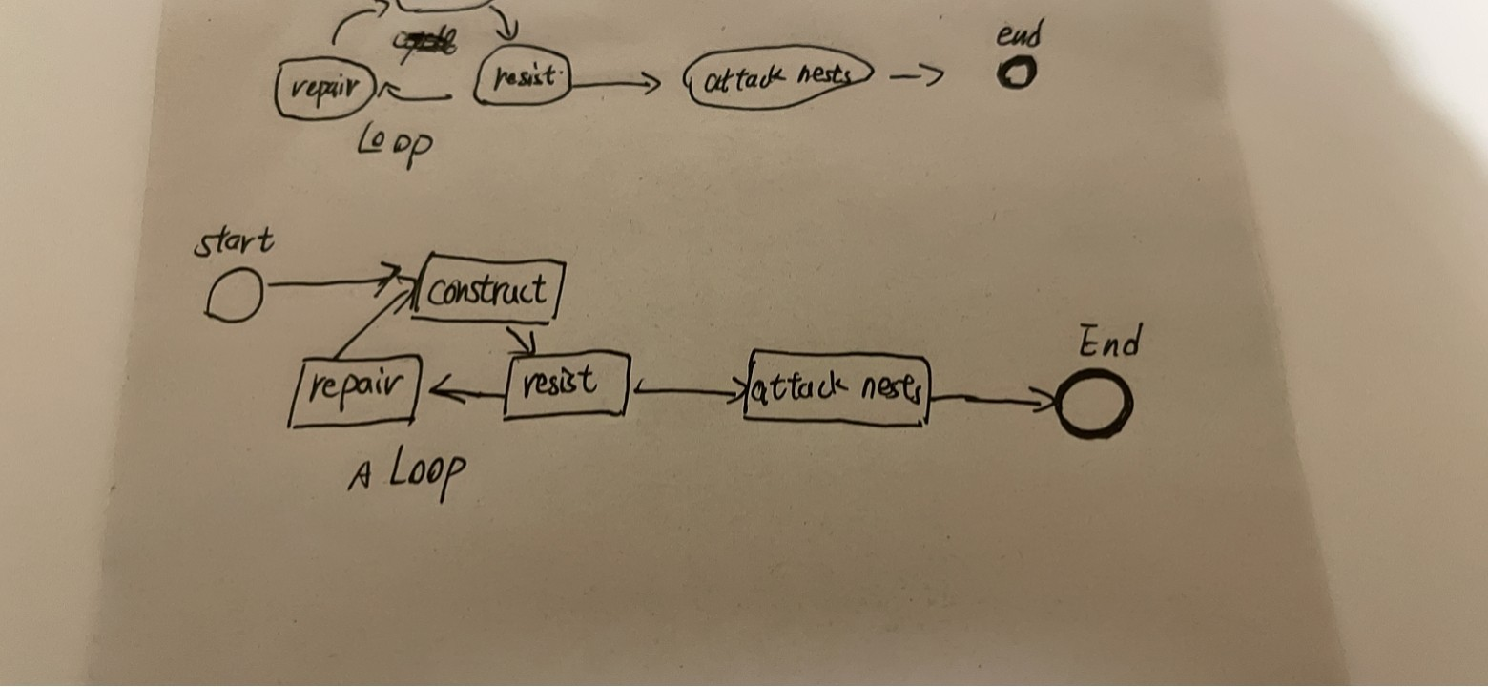
2.1.4. Play Flow
Fig4.1 play flow
The player can use materials to make refugees into civilians. They will leverage these materials to produce more tools, transforming civilians into workers and soldiers. Workers can build more structures after the materials for these buildings are provided. The player can construct additional walls and annexes. Once the base has enough buildings, the player can produce shields to turn civilians into defenders.
As time progresses, enemies will attack the base, and soldiers will defend against these attacks using the walls, ultimately eliminating the enemies. After the battle ends, workers can repair damaged buildings with materials. Through the cycle of development, defense, and repair, the player will accumulate enough soldiers and defenders to attack the nests. The player can summon combatants to launch an attack. The game will end in failure if the player's health points reach zero or if the base is completely destroyed. Victory is achieved when the two nests are destroyed.

Slide 28
2. Mechanics
2.2.1. Physics
2.2.2. Movement
2.2.3. Objects
2.2.4. Actions
2.2.5. Combat
2.2.6. Economy

Slide 29
2.2.1. Physics
Since this is a 2D game, the character can only move left and right. It does not account for height differences, so bullets will not fall. However, the bullet will still disappear after reaching its range. The game map consists only of x and y planes, so all physical calculations will be two-dimensional.

Slide 30
2.2.2. Movement
2.2.2.1. General Movement
2.2.2.2. Other Movement

Slide 31
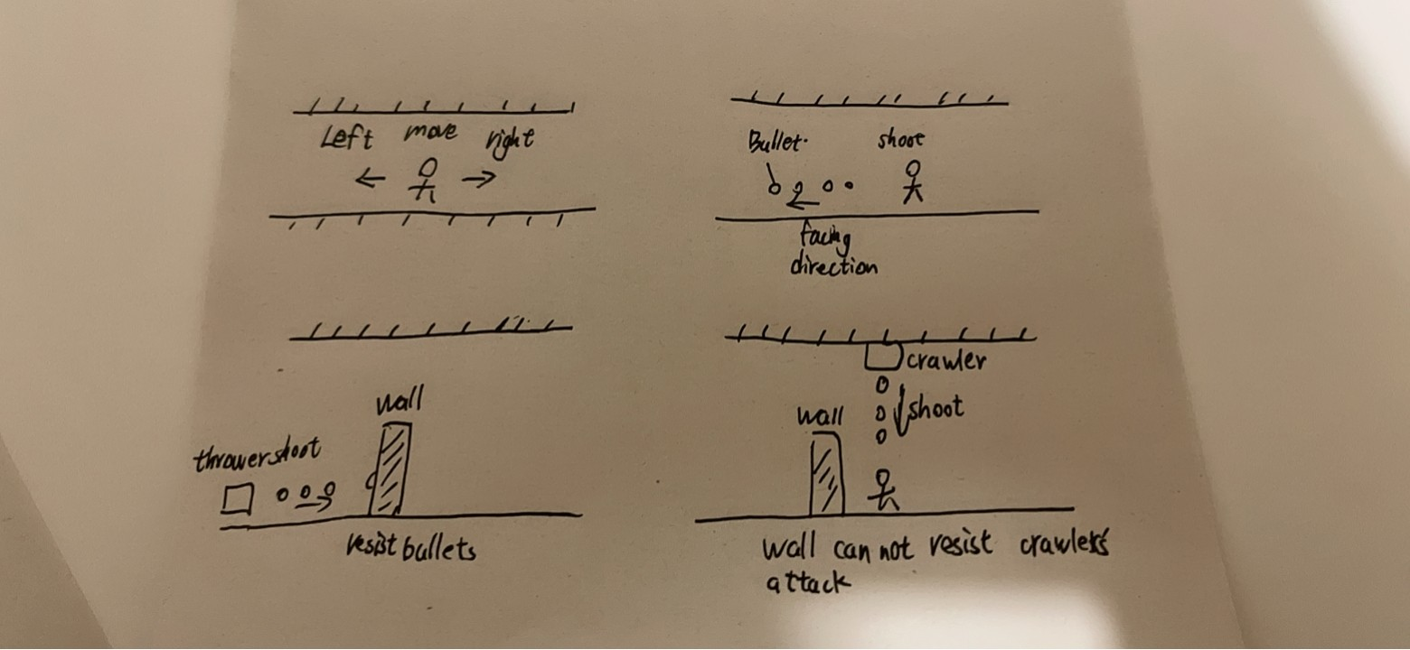
2.2.2.1. General Movement
Fig4.2 movement
Players use the 'A' and 'D' keys on the keyboard to move and the left mouse button to control attacks. The perspective is always centered around the character controlled by the player. Players move at a fixed speed. Pressing 'Shift' allows players to expend energy for quick movements for a short period. After running out of stamina, the player will stop their fast movement and move at a slower speed than usual. Stamina will slowly recover. If the player stops moving, their stamina will recover more quickly.

Slide 32
2.2.2.2. Other Movement
Soldier/Defender: They will stand after behind/on front? the wall. If the player buys some materials, they will move with the player.
Worker: They will move to any places that need them.
Civilian: They try to move the places that exist tools.
Refugee: They randomly move in a fixed area.
Enemies: They attack any buildings.

Slide 33
2.2.3. Objects
2.2.3.1. Picking Up Objects

Slide 34
2.2.3.1. Picking Up Objects
Sometimes enemies will drop some materials, players need to get close to them to get them.

Slide 35
2.2.4. Actions
2.2.4.1. Switches and Buttons
2.2.4.2. Aiming and Shooting

Slide 36
2.2.4.1. Switches and Buttons
When the game is paused, the player can change the game’s settings and save the game.

Slide 37
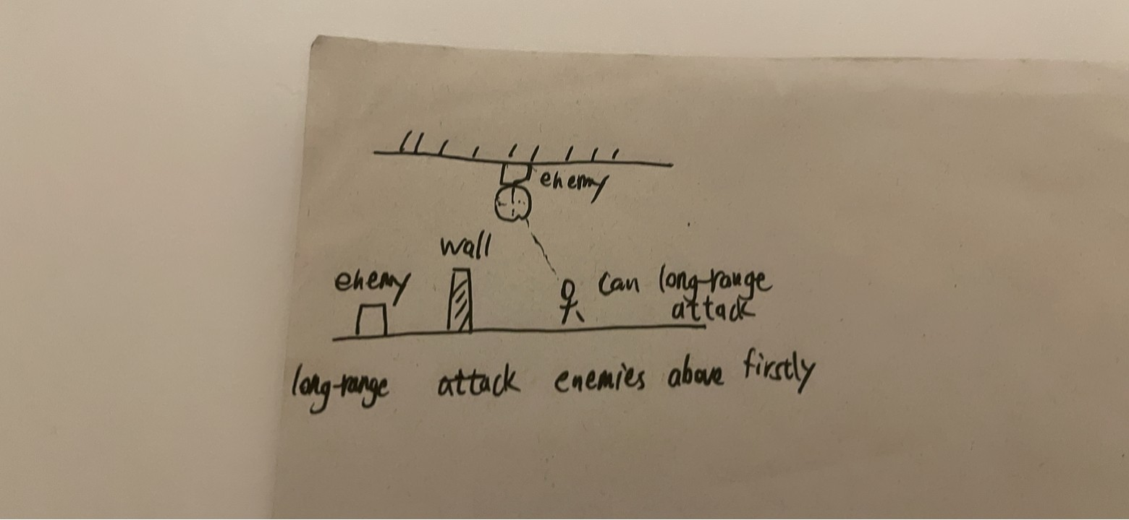
2.2.4.2. Aiming and Shooting
Fig4.3 shooting
The player does not need aim to shoot. Bullets will be shot in the direction facing the player. The Normal Attack is auto aim.
Fig 4.4 aiming
Remote attacks prioritize targeting enemies above.

Slide 38
2.2.5. Combat
Fig 4.5 thrower attack
Fig 4.6 crawler attack
Bullet:
Players and some enemies can shoot, usually the enemy's bullets are green and the player's bullets are orange. This allows players to distinguish which bullets belong to themselves and which belong to enemies. Our bullets can pass walls and shields to attack enemies.
Barrier:
Shield and wall can resist bullets. But if they are hit multiple times, they will be destroyed. The shield needs time to be repaired. If the wall is completely destroyed, it will require the expenditure of materials for reconstruction. Otherwise, only the worker needs to fix it. The wall can be upgraded, and the upgraded wall can withstand multiple attacks.
Enemy:
Crawler: The enemy will attack from above. This allows their attacks to ignore the wall. But shields can still block their attacks. Only long-range attacks can harm them.
Attacker:
The enemy will approach and attack.
Thrower: The enemy will maintain a distance from the attacking target and shoot bullets for attack.

Slide 39
2.2.6. Economy
The player can get materials from factories and enemies. The player can Players can spend materials to build buildings and walls, produce tools, upgrade buildings and bases, and repair and rebuild buildings.

Slide 40
3. Screen Flow
2.3.1. Screen Flow Chart
2.3.2. Screen Descriptions

Slide 41
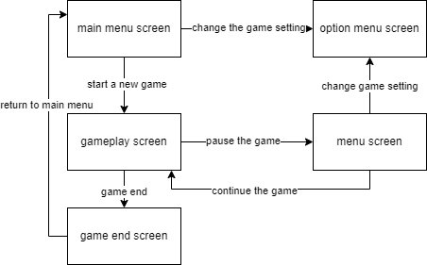
2.3.1. Screen Flow Chart
Fig4.7 screen flow

Slide 42
2.3.2. Screen Descriptions
2.3.2.1. Main Menu Screen
2.3.2.2. Options Menu Screen
2.3.2.3. Gameplay Screen
2.3.2.4. Menu Screen
2.3.2.4. Game End Screen

Slide 43
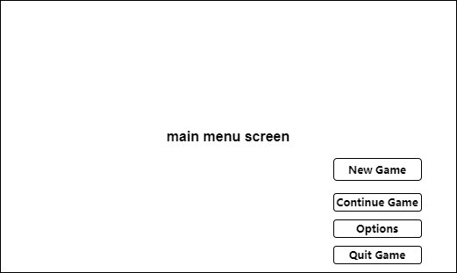
2.3.2.1. Main Menu Screen
Fig4.8 main menu screen
It will show the game’s title. And the screen will supply 4 options.

Slide 44
It will show the game’s title. And the screen will supply 4 options.
New Game: Start a new game.
Continue Game: Continue a game from a game save.
Options: Open options menu.
Quit Game: Kill the game process.

Slide 45
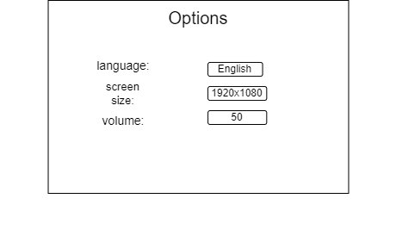
2.3.2.2. Options Menu Screen
Fig4.9 options menu
The player can change game’s settings, such as language, screen size, music volume and key settings.

Slide 46
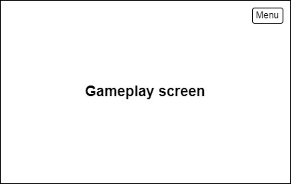
2.3.2.3. Gameplay Screen
Fig4.10 gameplay screen
It will show the game’s content. The player can pause the game and open menu screen.

Slide 47
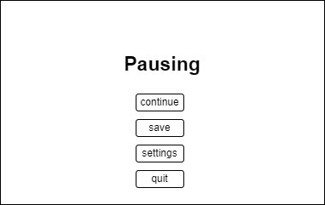
2.3.2.4. Menu Screen
Fig4.11 menu
The game will be paused. The player can save the game on the screen. At the same time, the player can quit the game on the screen.

Slide 48
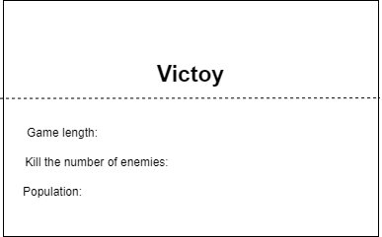

2.3.2.4. Game End Screen
Fig4.12 game end of victory
Fig4.13 game end of failure
The scree will show some statistical data about this game, such as game length. It will not take up too long time.Then, the game will jump to main menu screen.

Slide 49

4. Replaying and Saving
The player can save the game at any time. The game save will save the information of all characters, contains the player, enemies, and buildings. If the player continue game from a game save, the program will load all from the save file. But the game will not save actions, just save status. For example, if the thrower,a kind of enemy, is shooting when saving game, the thrower need re-shooting after the program load the game save. So, the information of bullets will not be saved.

Slide 50
Story, Setting and Character
03

Slide 51
Story, Setting and Character
The meteorite that falls from the sky brings a kind of unknown mutated creature, and the humans have to retreat to the underground tunnels. The player's base is the underground part of a subway station, and the player must hold their ground against the attack of mutated creatures.

Slide 52
4.Interface
04

Slide 53

4.Interface
1. Visual System
2. Control System
3. Audio
4. Help System

Slide 54
1. Visual System
4.1.1. HUD (Heads up display)
4.1.4. Camera

Slide 55

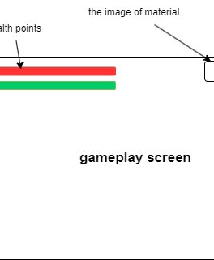
4.1.1. HUD (Heads up display)
Fig 5.1 HUD
There are two long rectangles on the left top to show health points and stamina.
On the right top, the screen will show the specific number of materials and the button of menu.

Slide 56
4.1.4. Camera
The camera will focus on the player. And it moves with the player.

Slide 57
2. Control System
The player use ‘A’ and ‘D’ to control the character’s movement. Clicking the left mouse button to shoot bullets. The player using ‘E’ to interact with buildings. If the player want to open the menu, he should click the menu button or click ‘Esc’ button on keyboard.

Slide 58

3. Audio
I will download free audio from internet libraries.

Slide 59
4. Help System
If the player enters a specific part of the game, the game will provide a short text notification in the upper right corner, such as a large number of enemies are coming. At the same time, some ICONS will also be displayed in the upper right corner to remind the player.

Slide 60
5. Technical
05

Slide 61
5. Technical
1. Target Hardware
2. Development hardware and software
3. Game Engine
4. Scripting Language

Slide 62
1. Target Hardware
MINIMUM:
OS: | Windows 7
Processor: | Intel 4th Gen Dual Core 2.0Ghz
Memory: | 2 GB RAM
Graphics: | Nvida GTX Series 8
Storage: | 4 GB available space
Additional Notes: | The game can likely run on lower rated hardware, but I can't guarantee the performance or provide support.

Slide 63
2. Development hardware and software
5.2.1 Hardware
5.2.2 Software

Slide 64
5.2.1 Hardware
OS: | Windows 11(x64)
Processor: | 13th Gen Intel(R) Core (TM) i9-13980HX 2.20 GHz
Memory: | 32.0 GB
Graphics: | Nvida RTX 4090 laptop
Storage: | 1 TB available space

Slide 65
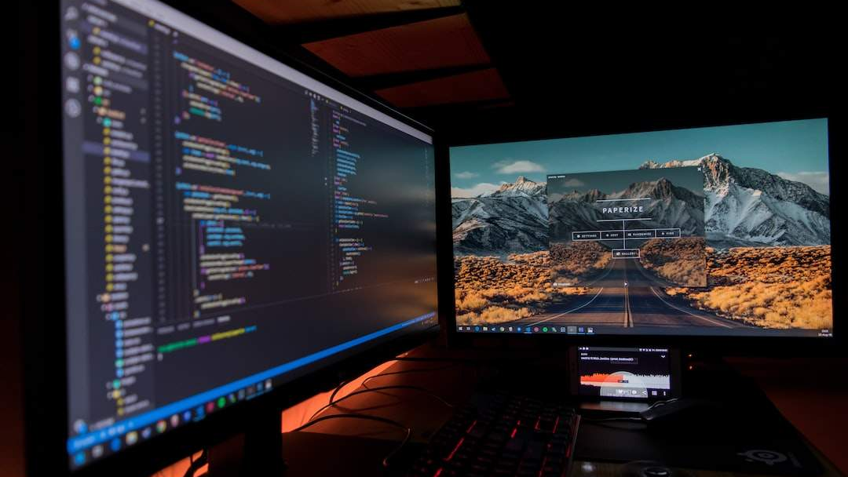

5.2.2 Software
Godot v4.12 is the latest official version when I started developing the prototype.
Git,Microsoft Visual Studio,etc.

Slide 66

3. Game Engine
Godot is a cross-platform, free and open-source game engine released under the permissive MIT license. It was initially developed by Argentine software developers Juan Linietsky and Ariel Manzur for several companies in Latin America prior to its public release in 2014. The development environment runs on many platforms, and can export to several more. It is designed to create both 2D and 3D games targeting PC, mobile, and web platforms and can also be used to develop non-game software, including editors.
Godot allows video game developers to create 3D and 2D games using multiple programming languages, such as C#, C++, GDscript.[3]

Slide 67
4. Scripting Language
The scripting language that will be used for this project is C#. Because it is one of the main languages of choice for scripting in the Godot game engine.

Slide 68
Project Management
06

Slide 69

Project Management
3. Version control
2. Detailed Schedule
4. Risk Analysis
1. Project Methodology
5. Test Plan

Slide 70
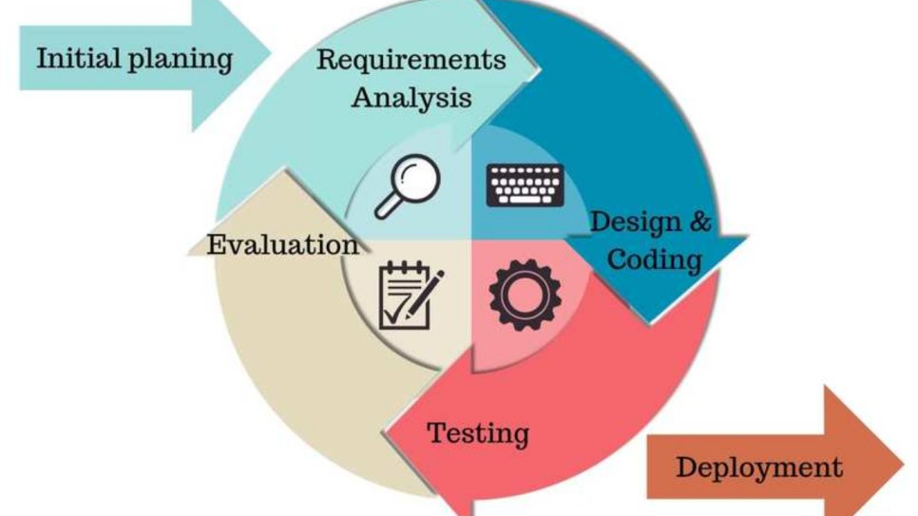

1. Project Methodology
In this game development project, I chose to adopt an agile development method. Agile methodologies are known for their high adaptability to rapid change and uncertainty and are well suited to meet the ever-changing needs and challenges of game development. In contrast to the waterfall model, agile development divides the development process into shorter iterative increments. At the end of each iteration, a final usable product is produced. If requirements change, the method can be developed in the next iteration cycle.
Fig 6.1 agile development

Slide 71
2. Detailed Schedule
 | date | Sprint(2 weeks) | Goals | Tasks
1 | 2024.1.22 | Prototype development and basic framework | Establish the basic framework and prototype of the game. | Develop the most basic game mechanics and a simple user interface.
2 | 2024.2.5 | Core Game Gameplay Development | To achieve the core gameplay of the game | Encode the main game features, such as motion control and basic interaction.
3 | 2024.2.19 | Map Design and Development | Design and implement preliminary game map. | Create map of the game and integrate them into the game
4 | 2024.3.4 | Advanced features and interactivity | Add advanced gaming features and interactivity. | Implement special effects, complex game logic, etc.
5 | 2024.3.18 | Testing and Optimization | To test the game and resolve any issues discovered | Conduct system testing, optimize performance, and improve user interface.
6 | 2024.4.1 | Preparing for Beta Release | Prepare for the beta version of the game. | Make final adjustments and optimizations

Slide 72
3. Version control
Github is a hosting platform for open source and proprietary software projects. As an open source repository and version control system, Github has more than 9 million developer users. As more and more applications move to the cloud, Github has become the preferred method for managing software development and discovering existing code. So I'll use Github to keep pushing code after every sprint.
However, once the project exceeds 100MB, Github will refuse to upload it. So I only uploaded the part that designed the key code, not the whole project.

Slide 73
4. Risk Analysis
Risk Description | Risk Probability | Risk Impact | Risk Mitigation Strategy
Underestimating engineering difficulty | High | High
Contracting illness | Low | Low | Avoiding Sickness
Inability to meet deadlines | Med | Med
Lose of Report/Documentation | Low | High | Documentation stored on Baidu Yun Drive with regular Copies stored on several devices locally.
Lose of Project/Workspace | Med | High | Project stored on Baidu Yun Drive with regular Copies stored on several devices locally.kept on local devices.

Slide 74
5. Test Plan
 | Test Plan
When? | At the end of every sprint.
Who? | Members of available game groups
Where? | Send testers a test version of the game via the game forum. The lack of connection between developers and testers facilitates critical analysis.
What? | Specific problems found during development.
How? | The developer will not be present and will provide playtesters with the game executable and a short questionnaire. Outside of the questionnaire, they can also make any complaints or suggestions they may have.

Slide 75
Appendices
07

Slide 76
Appendices
References

Slide 77
References
1. Side-scrolling video game - Wikipedia
2. Tower defense - Wikipedia
3. Godot (game engine) - Wikipedia

Slide 78
THE END
THANKS

